Slide 1
Arduino UNO

Slide 2
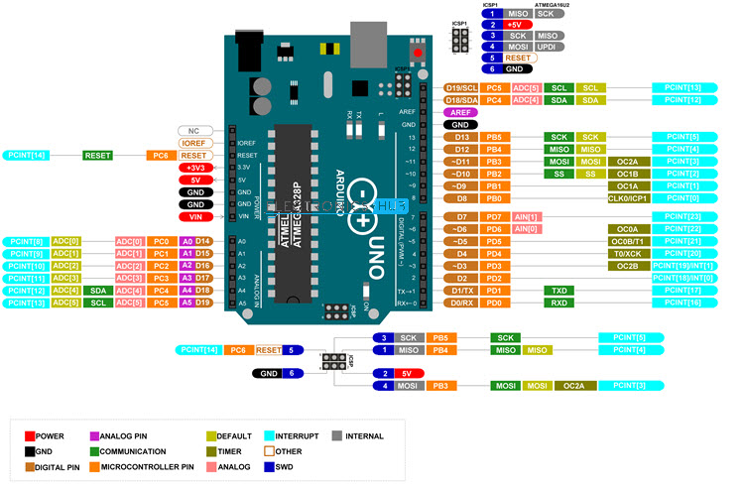
UNO pinout

Slide 3
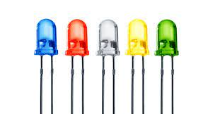
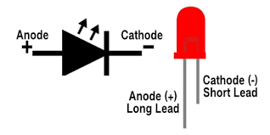
LEDs
LEDs come in different colors and intensities, and some include additional features, such as blinking or the capability to change color based on the software inputs. LEDs that can change color are called RGB (redgreen-blue) LEDs
Different sizes and colors
3mm, 5mm

Slide 4
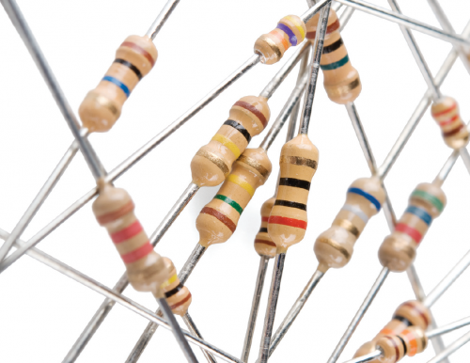
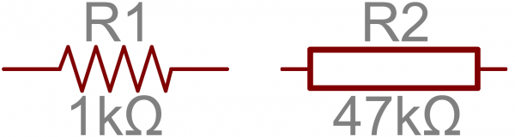
Resistors
Resistors limit the flow of current in a circuit.
Resistance is measured in ohms

Slide 5
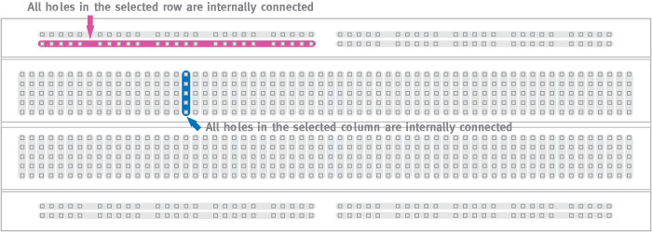
Breadboarding
A breadboard is a solderless device for temporary prototype with electronics and test circuit designs. Most electronic components in electronic circuits can be interconnected by inserting their leads or terminals into the holes and then making connections through wires where appropriate.

Slide 6
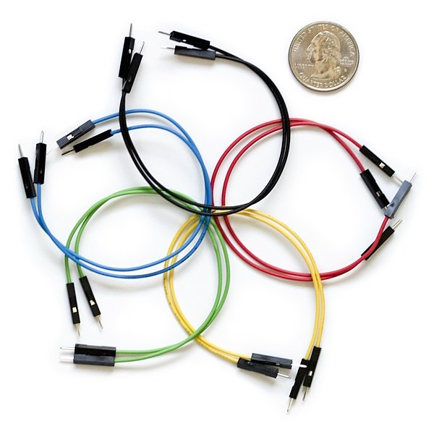
Jumper wires
Jumper wires are simply wires that have connector pins at each end, allowing them to be used to connect two points to each other without soldering. Jumper wires are typically used with breadboards and other prototyping tools in order to make it easy to change a circuit as needed.

Slide 7
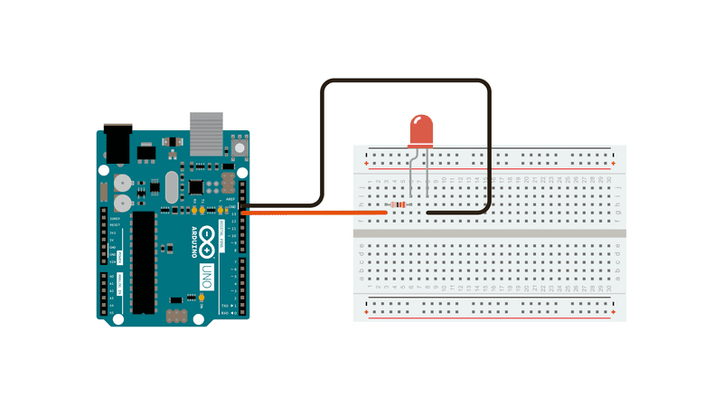
Blinking LED
Components
Arduino UNO
Red LED
Jumper wires
220 ohm resistor
Breadboard

Slide 8
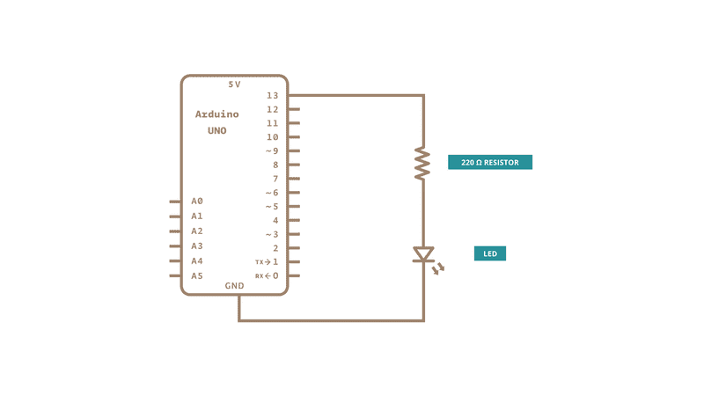
Blinking LED
void setup()
{
pinMode(13,OUTPUT);
}
void loop()
{
digitalWrite(13,HIGH);
delay(1000);
digitalWrite(13,LOW);
delay(1000);
}

Slide 9
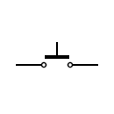
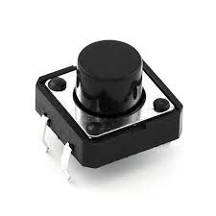
Switches
A Switch is a device which is designed to interrupt the current flow in a circuit. In simple words, a Switch can make or break an electrical circuit
When the contacts of a switch are closed, the switch creates a closed path for the current to flow and hence load consumes the power from source. When the contacts of a switch are open, no power will be consumed by the load

Slide 10
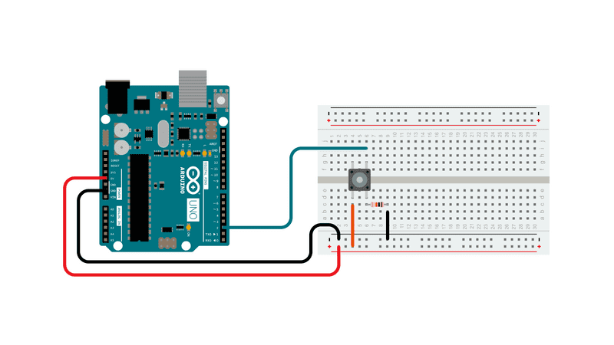
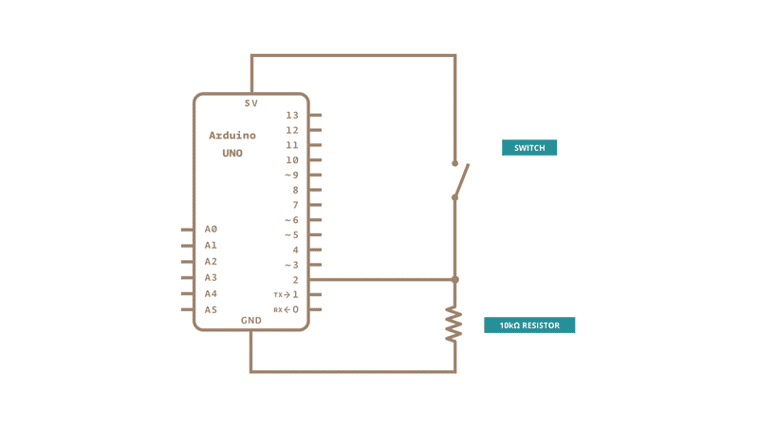
Button

Slide 11
Button
int buttonState = 0;
void setup()
{
pinMode(13,OUTPUT);
pinMode(2,INPUT);
}
void loop()
{
buttonState = digitalRead(2);
if(buttonState == HIGH)
digitalWrite(13,HIGH);
else
digitalWrite(13,LOW);
}
Button – 2
LED - 13
Read button status
If button pressed LED switched on
Else LED switched off

Slide 12
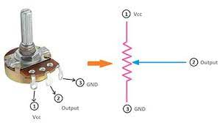
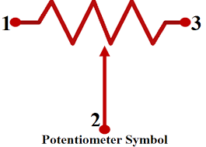
Potentiometer
Potentiometers are variable resistors and they function to alter their resistance via a knob or dial. You have probably used one before by adjusting the volume on your stereo or using a light dimmer.
Potentiometers have a range of resistance. They can be attuned from zero ohms to whatever maximum resistance that is specific to it. For example, a potentiometer of 10 kΩ can be adjusted from 0 Ω to its maximum of 10 kΩ.

Slide 13
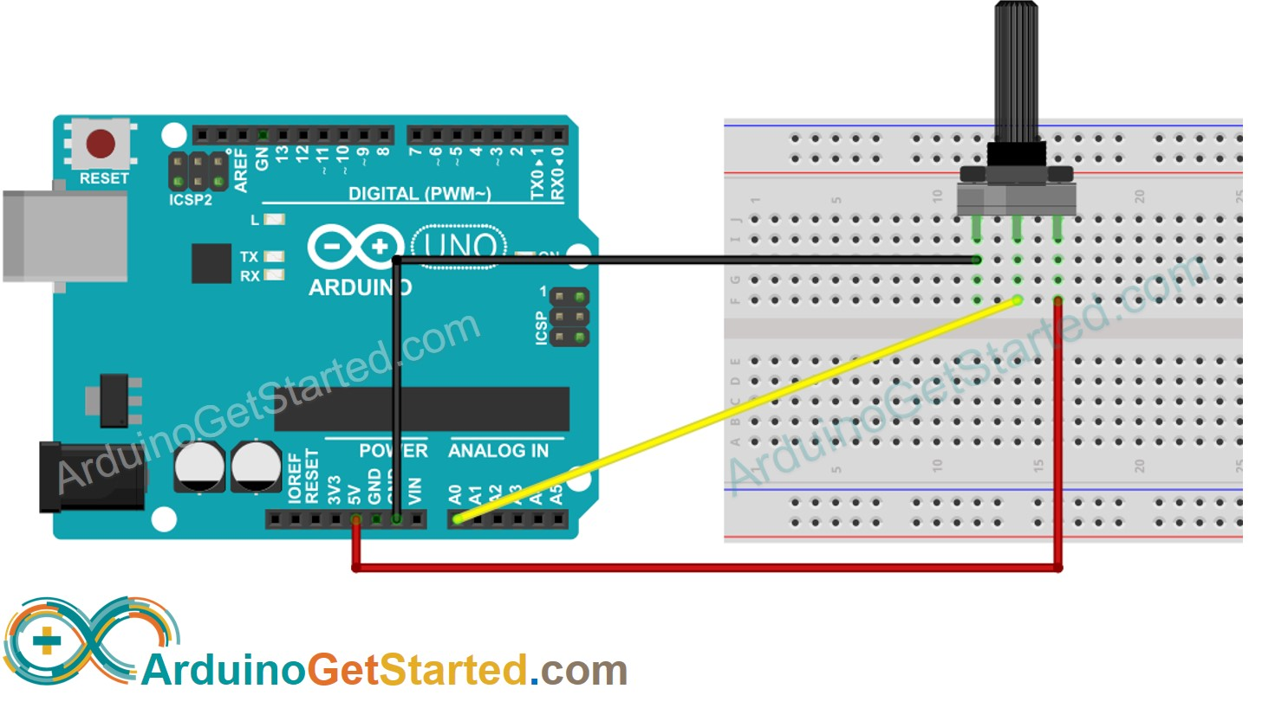
Potentiometer
Arduino UNO’s A0 to A5 can work as analog inputs
An analog pin converts an input value between 0 to 5V into a value between 0 to 1023
ADC
Analog i/p
Digital o/p

Slide 14
Potentiometer
int potValue;
void setup()
{
Serial.begin(9600);
}
void loop()
{
potValue = analogRead(A0);
Serial.println(potValue);
delay(1000);
}

Slide 15
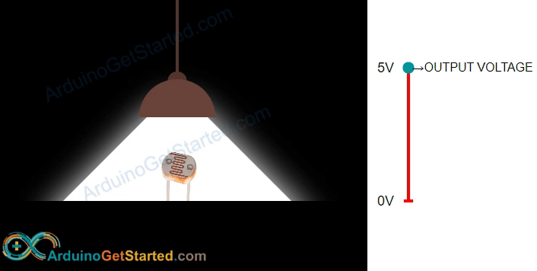
Light sensor
The light sensor we will use is the LDR – light dependent resistor also called a photoresitor. A photoresistor has two pins and since it is a kind of resistor we nee NOT distinguish between these pins. They are symmetric.
The more light the photoresistor is exposed to, the lesser will be its resistance. By measuring the photoresistor’s resistance we can know how bright the light is.

Slide 16
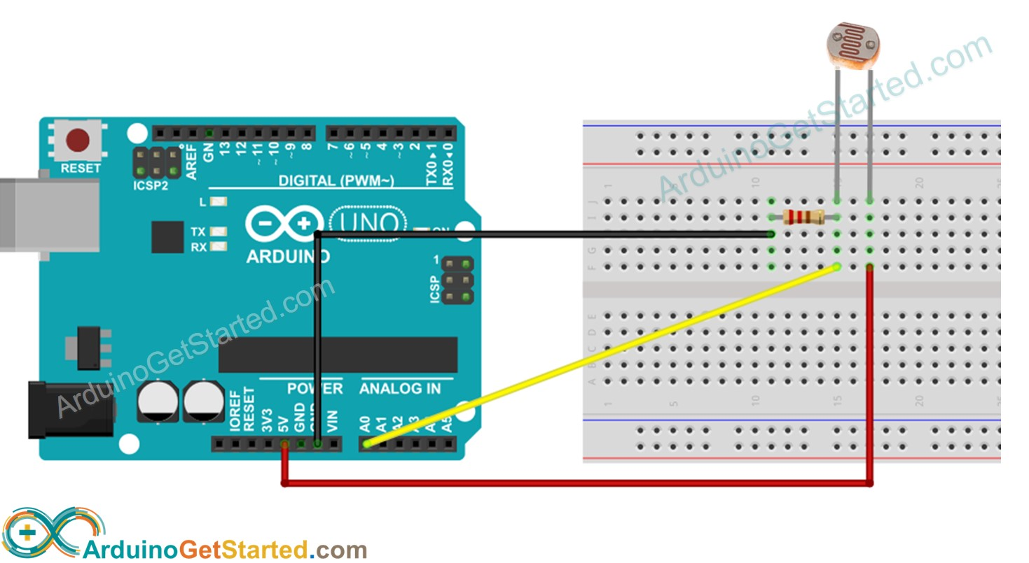
Light sensor
Components
Arduino UNO
LDR
10Kohm resistor
Breadboard
Jumper wires

Slide 17
Light sensor
Arduino UNO’s A0 to A5 can work as analog inputs
An analog pin converts an input value between 0 to 5V into a value between 0 to 1023
We will connect one pin of the LDR to an analog input (A0)
5V
LDR
A0
10K
GND

Slide 18
Light sensor
void loop() {
int analogValue = analogRead(A0);
Serial.print("Analog reading: ");
Serial.print(analogValue);
if (analogValue < 10) {
Serial.println(" - Dark");
} else if (analogValue < 200) {
Serial.println(" - Dim");
} else if (analogValue < 500) {
Serial.println(" - Light");
} else if (analogValue < 800) {
Serial.println(" - Bright");
} else {
Serial.println(" - Very bright");
}
delay(500);
}
void setup() {
Serial.begin(9600);
}

Slide 19
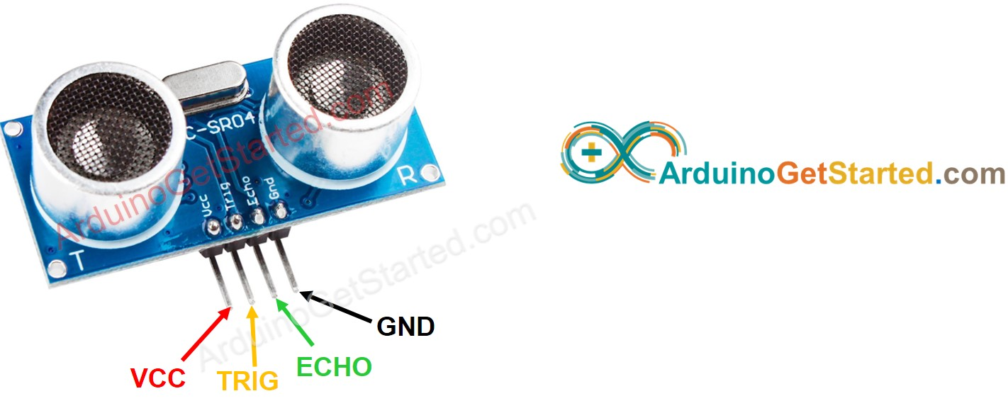
Ultrasonic sensor HC-SR04
VCC pin
Connected to VCC(5V)
GND pin
Connected to GND(0V)
TRIG pin
This pin receives trigger pulse from Arduino
ECHOpin
This pin sends a signal(pulse) to Arduino and Arduino measures the width of the pulse

Slide 20
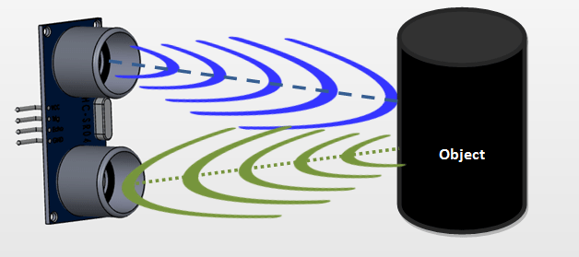
Ultrasonic sensor

Slide 21
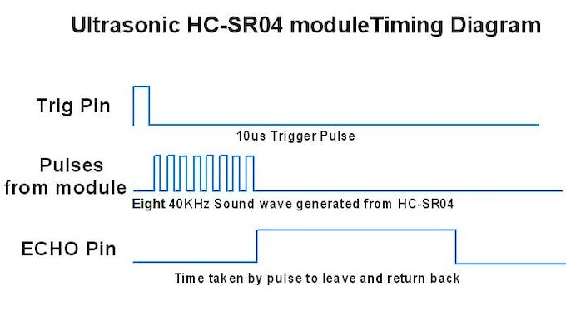
Ultrasonic sensor

Slide 22
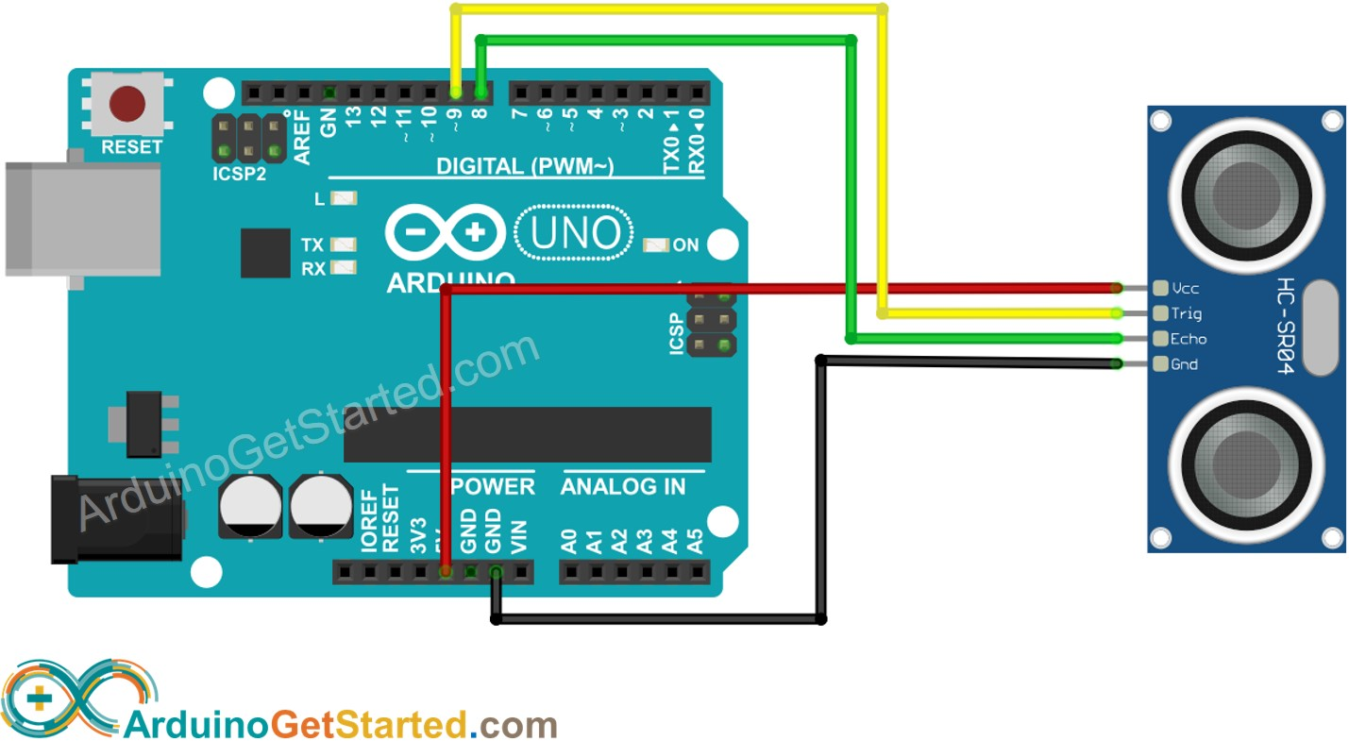
Wiring Diagram
TRIG – pin 9
ECHO – pin 8

Slide 23
Ultrasonic sensor
Travel time = Echo pulse duration (in microseconds)
Speed of sound = 340 m/sec = 0.034 cm/microseconds
Total distance = Travel time x Speed = Pulse duration x 0.034 cm
Distance to target = Total distance / 2 = Pulse duration x 0.017

Slide 24
Program
Trigger pulse generation
digitalWrite(9, HIGH);
delayMicroseconds(10);
digitalWrite(9, LOW);
Pulse duration
duration_us = pulseIn(8, HIGH);
Distance calculation
distance = duration_us x 0.017;
pinMode(trigPin, OUTPUT);
pinMode(echoPin, INPUT);

Slide 25
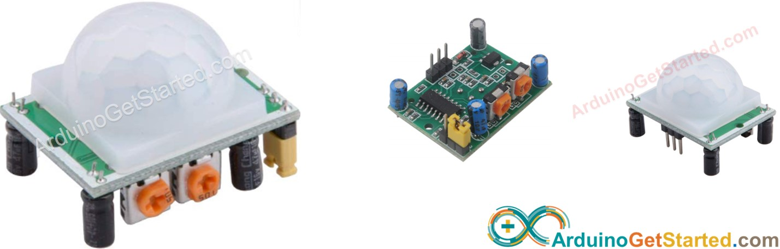
Motion sensor HC-SR501
HC-SR501 is a PIR(Passive Infrared sensor) that is used to detect presence of humans(animals). It is used in many applications (automatically switching on lights, opening doors, starting escalators)

Slide 26
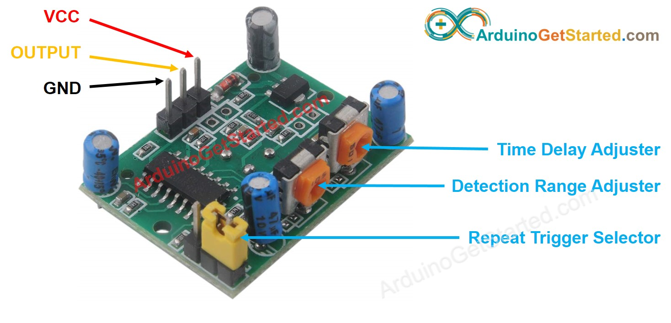
Motion sensor
VCC pin
Connected to VCC(5V)
GND pin
Connected to GND(0V)
OUTPUT
LOW when no motion and HIGH when motion is detected. Needs to be connected to a digital I/P pin of Arduino

Slide 27
Motion sensor
To be detected by the motion sensor
- The object should be moving
- Should be emitting IR radiation
Moving humans/animals satisfy both conditions
The motion sensor will not get triggered by stationary humans or moving vehicles

Slide 28
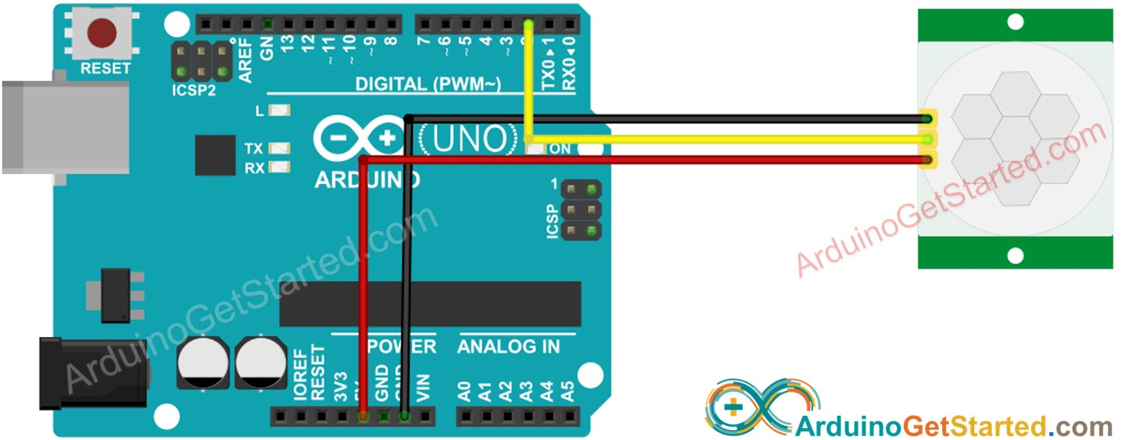
Wiring Diagram
OUTPUT – pin 2 on Arduino

Slide 29
Program
int pinStateCurrent = LOW;
int pinStatePrevious = LOW;
void setup() {
Serial.begin(9600);
pinMode(2, INPUT);
}
void loop() {
pinStatePrevious = pinStateCurrent;
pinStateCurrent = digitalRead(2);
if (pinStatePrevious == LOW && pinStateCurrent == HIGH)
Serial.println("Motion detected!");
else
if (pinStatePrevious == HIGH && pinStateCurrent == LOW)
Serial.println("Motion stopped!");
}

Slide 30
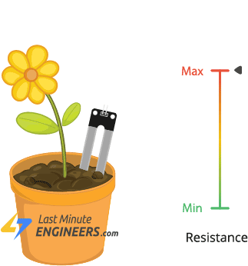
Soil Moisture sensor
The fork-shaped probe with two exposed conductors, acts as a variable resistor (just like a potentiometer) whose resistance varies according to the water content in the soil.
The more water in the soil means better conductivity and will result in a lower resistance.
The less water in the soil means poor conductivity and will result in a higher resistance.

Slide 31
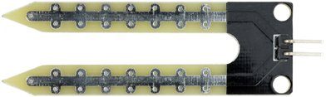
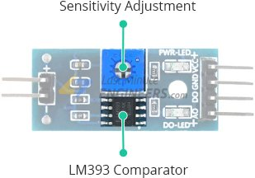
Soil Moisture sensor
Probe
The sensor contains a fork-shaped probe with two exposed conductors that goes into the soil or anywhere else where the water content is to be measured.
Like said before, it acts as a variable resistor whose resistance varies according to the soil moisture.
Module
The sensor also contains an electronic module that connects the probe to the Arduino.
The module produces an output voltage according to the resistance of the probe and is made available at an Analog Output (AO) pin.

Slide 32
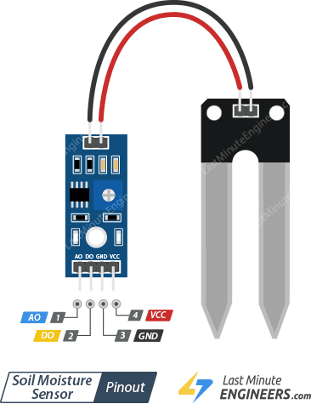
Pin out
AO (Analog Output) pin gives us an analog signal between the supply value to 0V and will be connected to one of the analog inputs on your Arduino.
DO (Digital Output) pin gives Digital output of internal comparator circuit. Y
VCC pin supplies power for the sensor. It is recommended to power the sensor with 5V.
GND is a ground connection.

Slide 33
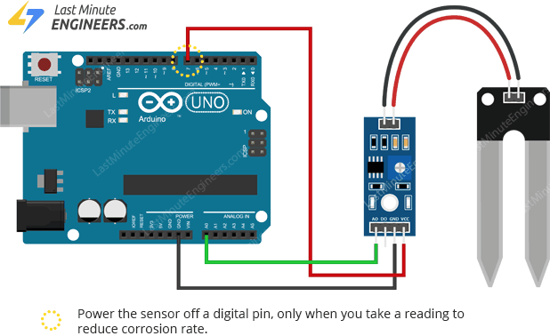
Wiring Diagram
Analog output of sensor connected to A0 pin of ARduino

Slide 34
Program
void setup()
{
Serial.begin(9600);
}
void loop(){
int sensorValue = analogRead(A0);
Serial.println(sensorValue);
delay(1000);
}

Slide 35
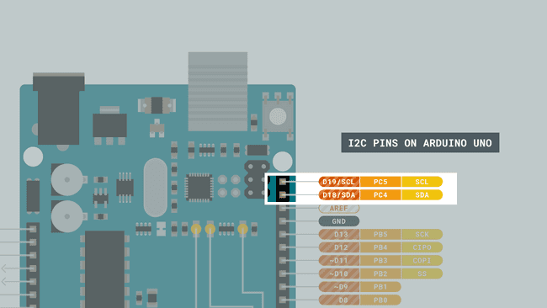
I2C sensor with UNO
I2C consists of two communication lines: SDA (data) and SCL (clock). Additionally, You will have to run power and ground to each device (or "slave"). Additionally, multiple I2C slaves can be connected on the same SDA and SCL lines, which means you could potentially numerous actuators and sensors while leaving almost all of your digital and analog pins free.

Slide 36
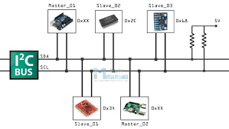
I2C sensor with UNO
When connecting multiple I2C devices to the same SDA and SCL lines, your Arduino needs a way to distinguish between the devices. It does this using the I2C address of each slave.. Most libraries will have a parameter for the address when you initialize the sensor.

Slide 37
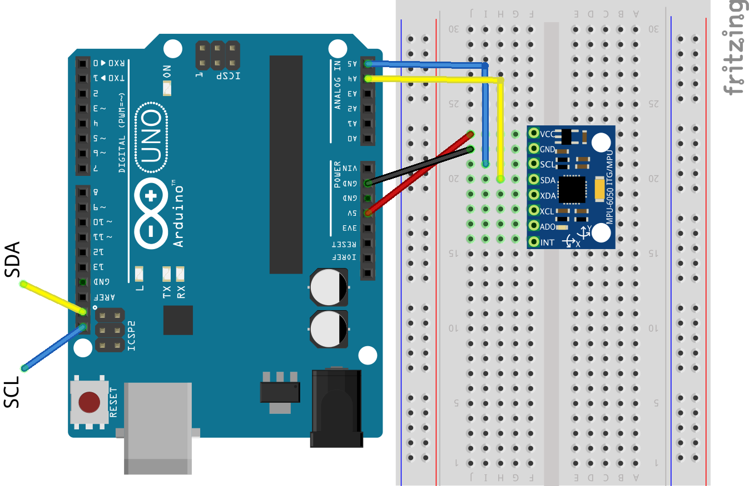
MPU6050 – UNO interface
MPU6050
3 axes accelerometer and gyro
Device address
Register address
Supply voltage 5V / 3.3V
Library available for most I2C devices
Basic Arduino library Wire.h

Slide 38
Interrupts
A method by which a processor can execute its normal program while continuously monitoring for some kind of event, or interrupt. There are two types of interrupts:
Hardware Interrupts - These occur in response to an external event, like a pin going high or low.
Software Interrupts - These occur in response to a software instruction.
Generally speaking, most 8-bit AVR microcontrollers (i.e. Arduinos) aren't innately capable of software interrupts, so we will focus on hardware interrupts.

Slide 39
Interrupts
When the event or interrupt happens, the processor takes immediate notice, saves its execution state, runs a small chunk of code (often called the interrupt service routine), and then returns back to whatever it was doing before.
The programmer defines the code that is to be executed when a particular interrupt occurs within the program itself. In Arduino, we use a function called attachInterrupt() to do this and the recommended syntax looks similar to the output below:
attachInterrupt(digitalPinToInterrupt(pin), ISR, mode)

Slide 40
Interrupts
attachInterrupt(digitalPinToInterrupt(pin), ISR, mode)
This function takes three parameters:
First Parameter (i.e. digitalPinToInterrupt(pin)) - Pin number of the interrupt, which tells the microprocessor which pin to monitor. The pin depends on the microcontroller being used.
Second Parameter (i.e. ISR) - The location of code we want to execute if this interrupt is triggered.
Third Parameter (i.e.mode) - Tells it what type of trigger to look for: a logic high, a logic low or a transition between the two.

Slide 41
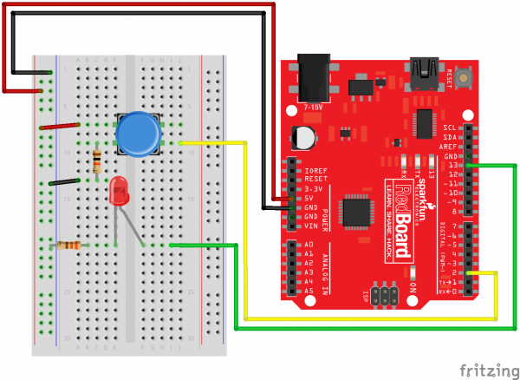
Interrupts
Pin 13 -- LED
Pin 2 -- Switch

Slide 42

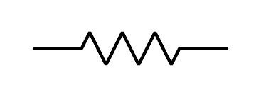
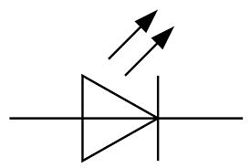
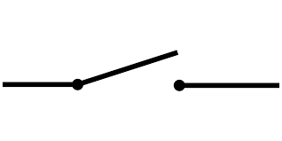
Interrupts
Arduino UNO
13
2
GND
GND

Slide 43
int ledPin = 13;
int x = 0;
void setup() {
pinMode(ledPin, OUTPUT);
attachInterrupt(0, increment, RISING);
Serial.begin(9600);
}
void loop() {
digitalWrite(ledPin, LOW);
delay(3000);
Serial.println(x, DEC);
}
void increment() {
x++;
digitalWrite(ledPin, HIGH);
}

Slide 44
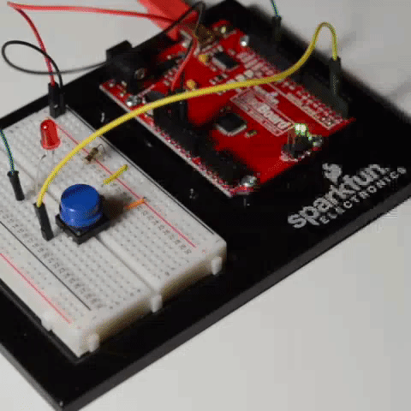
Interrupts
The main loop of this program sends an "OFF" signal to the LED every 3 seconds. Meanwhile, this program watches digital pin 2 (which corresponds to interrupt 0) for a rising edge. When this happens the function increment is called. The code within this function is executed, variable x is incremented, and the LED is turned on. Then the program returns to wherever it was in the main loop.
If you play around with it, you'll notice that the LED stays on for seemingly random amounts of time but never longer than 3 seconds. How long the LED stays on depends on where you interrupted the code in the main loop. For example, if the interrupt was triggered right in the exact middle of the delay function, the LED would remain lit for about 1.5 seconds after you hit the button.

Slide 45
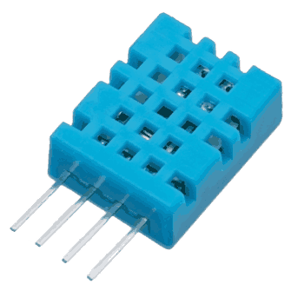
Case Study I: Temperature, Humidity Monitoring
DHT11 can measure temperature from 0°C to 50°C with ±2.0°C accuracy, and humidity from 20 to 80% with 5% accuracy.
Note that the sampling rate of the DHT11 is 1Hz, meaning you can get new data from it once every second.
DHT11

Slide 46
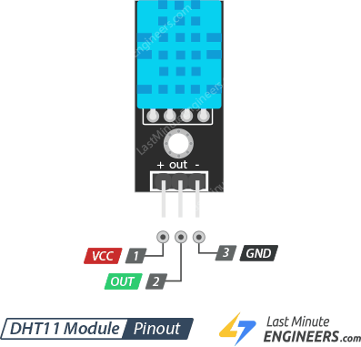
DHT11
VCC pin supplies power for the sensor. 5V supply is recommended, although the supply voltage ranges from 3.3V to 5.5V.
Out pin is used to communication between the sensor and the Arduino.
GND) should be connected to the ground of Arduino.

Slide 47
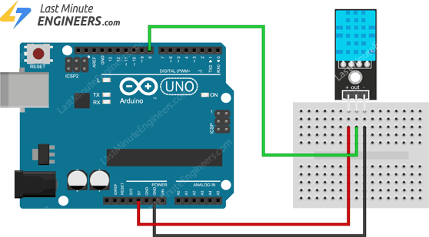
DHT11
VCC -- 5V
OUT --- pin8
GND --- GND

Slide 48
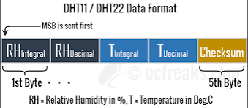
DHT11
DHT11 sensors have their own single wire protocol for transferring the data. This protocol requires precise timing. Fortunately, DHT Library was written to hide away all the complexities so that we can issue simple commands to read the temperature and humidity data.

Slide 49
DHT11
void loop() {
int readData = DHT.read11(outPin);
float t = DHT.temperature;
float h = DHT.humidity;
Serial.print("Temperature = ");
Serial.print(t);
Serial.print("°C | ");
Serial.print("Humidity = ");
Serial.print(h);
Serial.println("% ");
Serial.println("");
delay(2000); // wait two seconds
}
#include <dht.h> // Include library
#define outPin 8 // Defines pin number to which the sensor is connected
dht DHT; // Creates a DHT object
void setup() {
Serial.begin(9600);
}

Slide 50
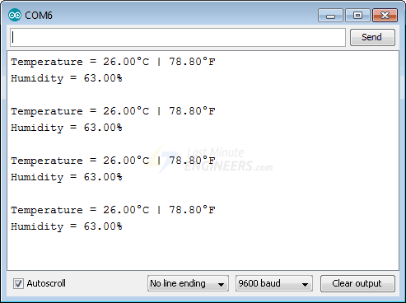
DHT11

Slide 51
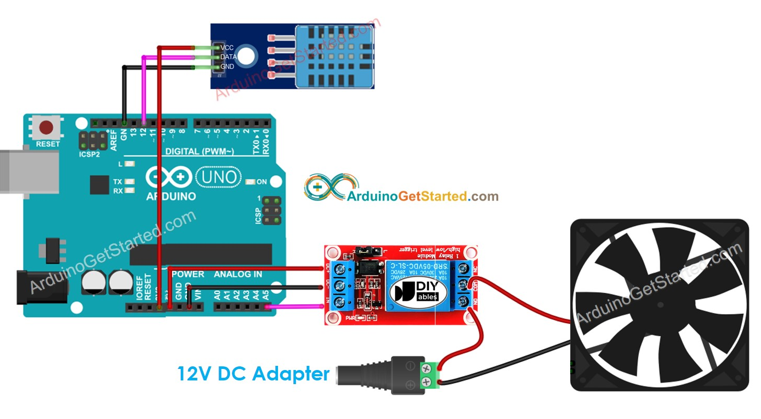
Temperature control

Slide 52
Temperature control
Components
Arduino UNO
DHT11 Temperature & Humidity sensor
Relay module
12V operated fan
How the system works
Arduino reads the temperature from DHT11
If temperature greater than upper threshold, fan is turned on
If temperature less than lower threshold, fan is turned off

Slide 53
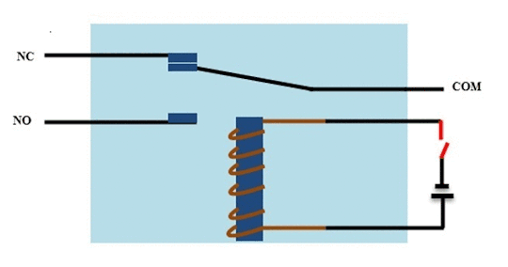
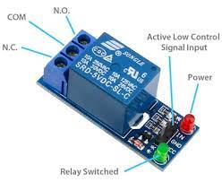
Relay module
NO- Normally Open
NC – Normally Closed

Slide 54
Code
#include "DHT.h“
#define RELAY_FAN_PIN A5 // Arduino pin connected to relay which connected to fan
#define DHTPIN 12 // Arduino pin connected to relay which connected to DHT sensor
#define DHTTYPE DHT22
const int TEMP_THRESHOLD_UPPER = 25; // upper threshold of temperature, change to your desire value
const int TEMP_THRESHOLD_LOWER = 20; // lower threshold of temperature, change to your desire value
DHT dht(DHTPIN, DHTTYPE);
float temperature; // temperature in Celsius

Slide 55
Code
void setup()
{
Serial.begin(9600);
dht.begin();
pinMode(RELAY_FAN_PIN, OUTPUT);
}

Slide 56
Code
void loop()
{
delay(2000);
temperature = dht.readTemperature();
if(temperature>TEMP_THRESHOLD_UPPER){
Serial.println(“Fan is turned on”);
digitalWrite(RELAY_FAN_PIN,HIGH);
}
elseif(temperature<TEMP_THRESHOLD_LOWER{
Serial.println(“Fan is turned off”);
digitalWrite(RELAY_FAN_PIN_LOW,LOW);
}
}

Slide 57
Case Study II: DHT11 values to Internet
We will be sending temperature and humidity data of your surroundings to Thingspeak platform where you can store, analyse and visualize the data using graphs and much more.
We will be using DHT11 sensor and GSM modem for accessing GPRS so that we can send the data to the server and Arduino will act as the brain of the project.
Two graphs will be generated on Thingspeak platform as we are sending only two data: temperature and humidity.
The data on the Thingspeak will be updated every 15 seconds.

Slide 58
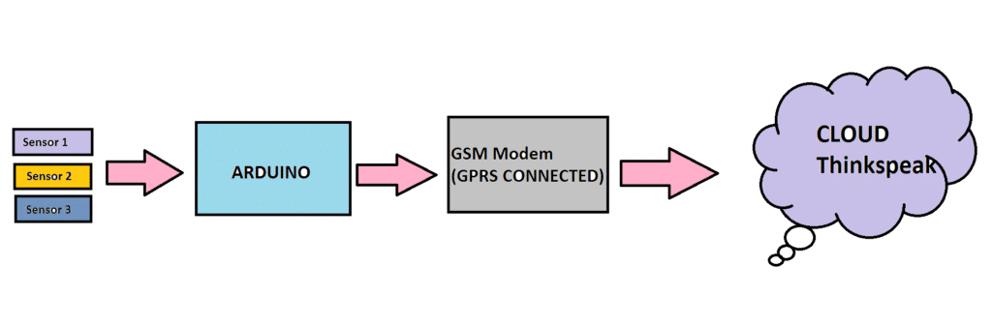
Case Study II

Slide 59
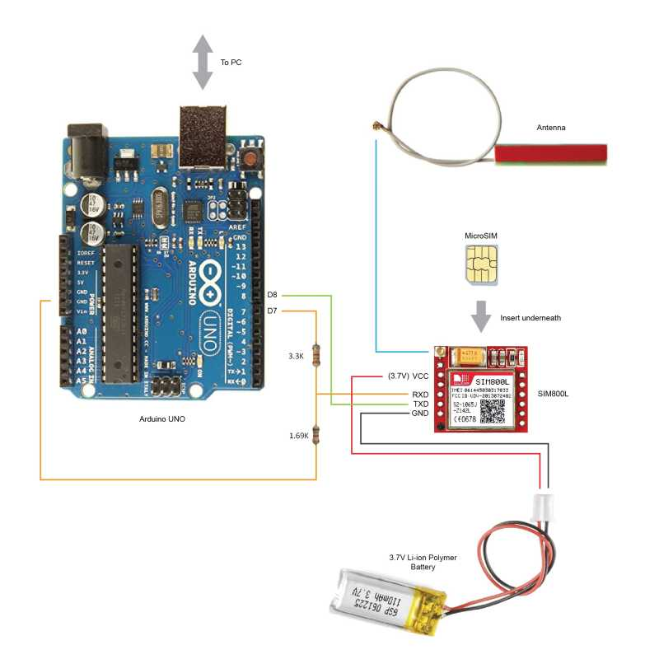
Case Study II
Arduino UNO
DHT11 Temperature & Humidity sensor
SIM800 GSM module
GSM(Global System for Mobile Communication)

Slide 60
Pin connections – UNO to SIM800
SIM800 | Arduino UNO
GND | GND
SIM_TXD | D8
SIM_RXD | D7
The interface between Arduino UNO and SIM800 is serial
The two signals in a serial interface - TX, RX

Slide 61
AT commands
Command | Description
AT | Synchronize baud rate
AT+IPR=9600 | Set baud rate at 9,600 bps
AT+CBC | Inquire charging status and remaining battery capacity
AT+CSQ | Inquire GSM signal quality
AT+GSV | Display product identification information
AT commands are short command keys used to execute the desired functions on the SIM800. We send these codes through the Arduino and it will relay the commands to the SIM800 for execution.

Slide 62
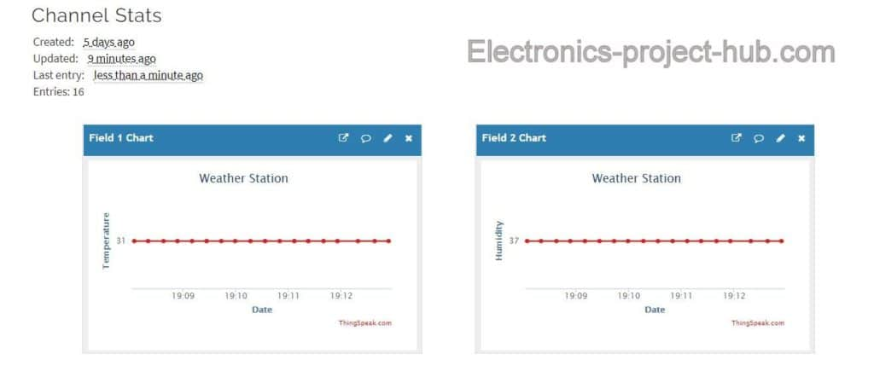
Thingspeak
Thingspeak is open source platform made for Internet of Things (IoT) device developers and learners where developers can send and log data to the server
We can send up to 8 data simultaneously to the Thingspeak account; the data uploaded will be converted to graphical representation automatically

Slide 63
API key in Thingspeak
API stands for “Application programing Interface”, on Thingspeak it is a string of random character contains alphabets of lower and upper case, numbers and even special characters to identify your account and ensures that your sent data doesn’t end on someone else’s account and vice-versa.
There are two API keys generated while creating an account; one is called read API key and another is called write API key. We will be using only the write API key as we are going to write data to the Thingspeak.

Slide 64
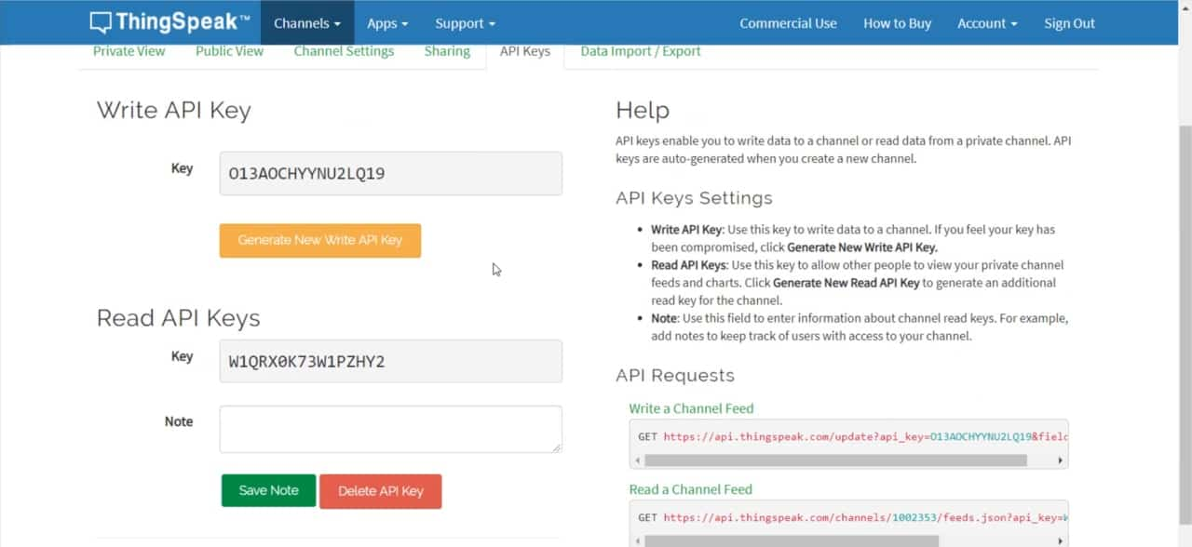
API keys

Slide 65

Thingspeak Channels
Once you have signed up and signed into ThingSpeak, you start by creating a ThingSpeak Channel.
A channel is where you send your data to store. Each channel includes 8 fields for any type of data

Slide 66
APN Access Point Name
APN stands for Access Point Name it is the gateway between carrier’s network and internet. GSM modem or any mobile device accessing internet must be configured with APN to present the wireless carrier. APN helps in getting the IP address and decides which security protocols should be used.
We should write the correct APN name for the mobile network / SIM that you have installed on the GSM modem in the program code, only then GSM modem can access the internet and send data to thingspeak platform.

Slide 67
Advantages of using GPS module
We are utilizing GSM modem to access the internet instead of Wi-Fi boards like ESP8266 so that our projects will be independent of Wi-Fi which has limited range and you may not able to move your project anywhere as you wish or you might need to carry a Wi-Fi hotspot device beside the project.
Say your project need to be place somewhere at the top of a building to collect some data like air quality or atmospheric pressure, with GPRS based internet access you can carry the project anywhere, but if we utilize ESP8266 in the project to access internet you will need a Wi-Fi hotspot device near the project.

